Slide 1
End-to-End Learning-based Video Streaming Enhancement Pipeline: A Generative AI Approach
Emanuele Artioli, Farzad Tashtarian, Christian Timmerer
Christian Doppler laboratory ATHENA | Klagenfurt University
emanuele.artioli@aau.at | https://athena.itec.aau.at/
NOSSDAV ‘25 | March 31st - April 3rd | Stellenbosch, South Africa

Slide 2
Agenda
Background & Challenge
ELVIS
Implementation
Experimental setup
Results
Takeaways
Q&A

Slide 3
Background
HTTP Adaptive Streaming
Throughput
Time
Server
Network
Client
Only low-level features, no content awareness!

Slide 4
ELVIS
(1) Removing redundant data (2) reconstructing it with GenAI (3) monitoring performance.
Server side
Frame extraction
Complexity calculation
Frame shrinking
Video encoding
Network
ELVIS controller
Performance monitoring
Client side
Video rendering
Frame in-painting
Frame stretching
Video decoding

Slide 5
Implementation

Slide 6
Experimental Setup
Origin Server (Encoder)
Network (Internet)
Client (Player)
Frame
Segment
BW
VMAF2
VMAF1
Video Transmission
Raw video
Decoding and Inpainting
BW
Received Segments
Encoded Video

Slide 7
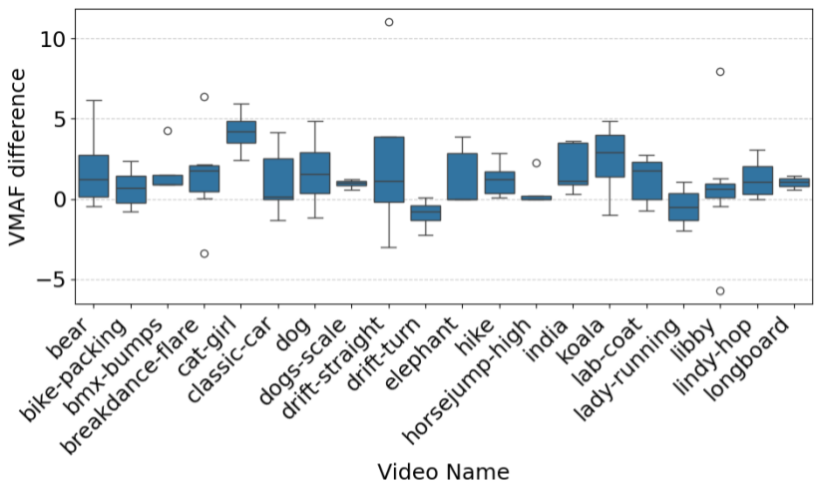
Results
ELVIS achieves up to 11 VMAF points improvement over standard streaming.
High computation cost: needs optimization for real-time use!

Slide 8
Key Takeaways
Generative AI can improve video quality without increasing bitrate.
ELVIS bridges the gap between general-purpose AI models and video streaming systems.
Time complexity remains the biggest challenge for high-resolution real-time streaming.

Slide 9
Thanks for your attention!
Github
Linkedin
Athena

